Slide 1
ARTCademy
“Arts and Crafts Academy”

Slide 2
Module 1. TEAM MANAGEMENT AND LEADERSHIP
This Project has been funded with support from the European Commission. This publication reflects the views only of the author, and the Commission cannot be held responsible for any use which may be made of the information contained therein.

Slide 3
UNIT 1. THE EFFECTIVE LEADER AND HIS/HER CHARACTERISTICS
This Project has been funded with support from the European Commission. This publication reflects the views only of the author, and the Commission cannot be held responsible for any use which may be made of the information contained therein.

Slide 4
Leader and Manager – are they the same?
Unit 1. Leadership and its characteristic
Leaders
Motivate and inspire people, empower and energise them - lead people
Managers
Ensure implementation of the vision and goals achievement
- manage work
Team management refers to techniques, processes and tools for organizing and coordinating a group of individuals working towards a common goal.
Leadership is about mapping out where you need to go to "win" as a team or an organization; and it is dynamic, exciting, and inspiring.
This Project has been funded with support from the European Commission. This publication reflects the views only of the author, and the Commission cannot be held responsible for any use which may be made of the information contained therein.

Slide 5
What is Emotional Intelligence?
Unit 1. Effective Leader and its characteristic
Personal competence Focuses on your individuality | Self – awareness Your ability to be aware and control your emotions and behaviour Self-management Ability to direct your emotions and behaviours positively, to stay flexible
Social competence Your ability to understand others people’s moods, behaviours and motives to improve your relationships | Social awareness/ empathy Your ability to understand others people’s emotions and motives Relationship management Your ability to use your awareness to manage interactions successfully
This Project has been funded with support from the European Commission. This publication reflects the views only of the author, and the Commission cannot be held responsible for any use which may be made of the information contained therein.

Slide 6
UNIT 2. LEADERSHIP STYLES
This Project has been funded with support from the European Commission. This publication reflects the views only of the author, and the Commission cannot be held responsible for any use which may be made of the information contained therein.

Slide 7
The main approaches toward leadership
Unit 2. Leadership Styles
Traits Approach
The leaders are born, not made; leadership consists of certain inherited personality traits or qualities.
Limitations: There is no guarantee that a person that characterizes with such traits will became an effective leader.
Behavioral Approach
The leadership can be learned and developed. Focuses on the accountabilities, responsibilities and functions of the leader and the nature of the group. Leaders are usually concerned either on the task or on the people.
Behavioral approach focuses on the behavior of people in leadership positions, the importance of leadership style and how it influences group performance.
This Project has been funded with support from the European Commission. This publication reflects the views only of the author, and the Commission cannot be held responsible for any use which may be made of the information contained therein.

Slide 8
Classical leadership styles by Kurt Lewin
Unit 2. Leadership Styles
Authoritarian - Autocratic style
Leaders spell out the goals, deadlines and methods while making-decisions on their own with little consultations with others.
Participative - Democratic style
Leader expresses his or her priorities and values in setting goals and making-decisions, but also takes part in the group’s work and accepts advice and suggestions from colleagues. However, the leader makes the final decision.
Delegative - Laissez-faire style
Leader hands over responsibility for results to the group. He or she lets them set goals, decide on work methods, define individuals’ roles and set their own pace of work.
This Project has been funded with support from the European Commission. This publication reflects the views only of the author, and the Commission cannot be held responsible for any use which may be made of the information contained therein.

Slide 9
The situational approach
Unit 2. Leadership Styles
Leader
Character, values, experience, opinions
Situation
Type of the task, organizational variables
Followers
Character, values, experience, opinions
Effective leaders select individual aspects from various leadership styles to best suit their needs.
There is no single "best" style of leadership. The most successful leaders are those who adapt their leadership style to the Performance Readiness (ability and willingness) of the individual or group they are attempting to lead or influence. Effective leadership varies, not only with the person or group that is being influenced, but it also depends on the task, job or function that needs to be accomplished.
Leadership style
This Project has been funded with support from the European Commission. This publication reflects the views only of the author, and the Commission cannot be held responsible for any use which may be made of the information contained therein.

Slide 10
Transformation leaders
Unit 2. Leadership Styles
Transformational approach to leadership is understood as the one that causes changes to social and individual systems as it creates valuable and positive changes in the followers with the end goal of developing followers into leaders.
Some quotations of transformative leaders:
Edwards Deming: “A bad system will beat a good person every time.”
Peter Drucker: “If you want something new, you have to stop doing something old.”
John D. Rockefeller: “Good leadership consists of showing average people how the superior people work.”
This Project has been funded with support from the European Commission. This publication reflects the views only of the author, and the Commission cannot be held responsible for any use which may be made of the information contained therein.

Slide 11
UNIT 3. EFFECTIVE COMMUNICATION IN LEADING PEOPLE
This Project has been funded with support from the European Commission. This publication reflects the views only of the author, and the Commission cannot be held responsible for any use which may be made of the information contained therein.

Slide 12
The process of effective communication
Unit 3. EFFECTIVE COMMUNICATION IN LEADING PEOPLE
Thought
Encoding
Decoding
Thought: First, information exists in the mind of the sender. This can be a concept, idea, information, or feeling.
Encoding: Next, a message is sent to the receiver in words or other symbols.
Decoding: Lastly, the receiver translates the words or symbols into a concept or information that a person can understand.
This Project has been funded with support from the European Commission. This publication reflects the views only of the author, and the Commission cannot be held responsible for any use which may be made of the information contained therein.

Slide 13
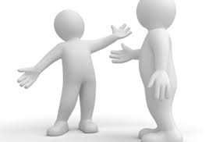
Communication Forms
Unit 3. EFFECTIVE COMMUNICATION IN LEADING PEOPLE
Verbal communication that consists of delivering information by the spoken words
Non-verbal communication that is the process of communication through sending and receiving wordless cues between people
Non-verbal communication encompasses much more that only body language.
Non-verbal communication encompasses: Appearance (cloths),Zones – Distance, Facial expression (eye contact), Body language (gestures), Touch, Voice (tone, pitch, force), Good manners.
There is also the written communication that is simply the conveyance of information or instruction by utilizing the written words.
To be an effective team leader, you need to be fluent in all forms of communication!
This Project has been funded with support from the European Commission. This publication reflects the views only of the author, and the Commission cannot be held responsible for any use which may be made of the information contained therein.

Slide 14
Effective feedback
Unit 3. EFFECTIVE COMMUNICATION IN LEADING PEOPLE
Feedback is important in leading people, it is key in the mentoring relationship, and performs a valuable role in:
improving self awareness
enhancing self esteem
raising morale
encouraging people to want to learn
offering reassurance
motivation
improving individual performance
Effective feedback
Balanced
Clear
Owned
Regular
Specific
Given in a good time
Sandwich technique
KISS technique
This Project has been funded with support from the European Commission. This publication reflects the views only of the author, and the Commission cannot be held responsible for any use which may be made of the information contained therein.

Slide 15
UNIT 4. TEAM BUILDING AND DEVELOPMENT
This Project has been funded with support from the European Commission. This publication reflects the views only of the author, and the Commission cannot be held responsible for any use which may be made of the information contained therein.

Slide 16
Effective team characteristics
Unit 4. TEAM BUILDING AND DEVELOPMENT
A team is a group of individuals,
all working together
for a common purpose.
Shared values
Mutual trust
Inspiring vision and goal
Skills required to perform tasks
Rewards – recognition of achievement toward objectives
This Project has been funded with support from the European Commission. This publication reflects the views only of the author, and the Commission cannot be held responsible for any use which may be made of the information contained therein.

Slide 17
Team development model
Unit 4. TEAM BUILDING AND DEVELOPMENT
Identified by Tuckman, offers a foundational definition of the stages teams go through during their lifecycle.
Forming
when people start to resolve their differences, appreciate colleagues' strengths
Performing
Norming
Storming
the team is forming and members start to know each other
people start to push against the boundaries established in the forming stage
the team reaches the performing stage when hard work leads to the achievement of the team's goal
This Project has been funded with support from the European Commission. This publication reflects the views only of the author, and the Commission cannot be held responsible for any use which may be made of the information contained therein.

Slide 18
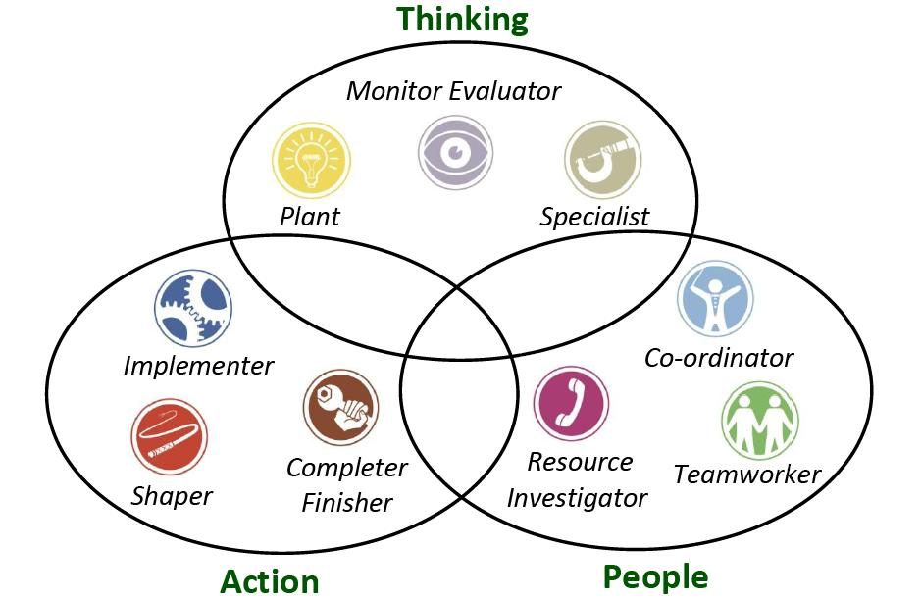
Team roles
Unit 4. TEAM BUILDING AND DEVELOPMENT
According to Belbin, the most successful teams require different type of team roles. There are supposed to be members in every team, that are:
People oriented
Action oriented
Thinking oriented
This Project has been funded with support from the European Commission. This publication reflects the views only of the author, and the Commission cannot be held responsible for any use which may be made of the information contained therein.

Slide 19
UNIT 5. MOTIVATING PEOPLE
This Project has been funded with support from the European Commission. This publication reflects the views only of the author, and the Commission cannot be held responsible for any use which may be made of the information contained therein.

Slide 20
What is motivation?
Unit 5. MOTIVATING PEOPLE
Employee motivation has been broadly defined as the psychological forces that determine the direction of a person's behavior in a team or an organization. Employee motivation describes how committed is an employee to his job, how engaged he feels with the company's goals and how empowered he feels in his daily work.
Why is it important?
Motivated workers are more satisfied and happy at work, stay focused and work more effectively to meet goals and obtain the rewards they seek. Motivated employees can help to increase quality of the work and productivity as well as reduce costs.
This Project has been funded with support from the European Commission. This publication reflects the views only of the author, and the Commission cannot be held responsible for any use which may be made of the information contained therein.

Slide 21
Cognitive evaluation theory
Unit 5. MOTIVATING PEOPLE
Job motivation can be extrinsic or intrinsic, meaning an employee's motivating factors can come from internal or external sources.
Intrinsic motivators: achievement, responsibility and competence, motivators that come from the actual performance of the task or job – the intrinsic interest of the work.
Extrinsic motivators: pay, promotion, feedback, working conditions – things that come from a person's environment, controlled by others.
This Project has been funded with support from the European Commission. This publication reflects the views only of the author, and the Commission cannot be held responsible for any use which may be made of the information contained therein.

Slide 22
Maslow hierarchy of needs
Unit 5. MOTIVATING PEOPLE
What do the people expect?
As a leader, you can help them find what they are looking for
Needs | Home | At the work place
Self-actualization | Education, religion, hobbies, personal growth | Training, advancement, growth, creativity
Esteem | Approval of family, friends, community | Recognition, high status, responsibility,
Belongingness | Family, friends, clubs | Teams, co-workers, clients, leaders, subordinates, relationships
Safety | Freedom from war, violence | Work safety, job security, health insurance
Physiological | Food, | Heat, air-conditioning, base salary, breaks,
This Project has been funded with support from the European Commission. This publication reflects the views only of the author, and the Commission cannot be held responsible for any use which may be made of the information contained therein.

Slide 23
How to motivate people?
Unit 5. MOTIVATING PEOPLE
Use compliments
Find out what motivates your people
Ways to give praise are limited only by your imagination
Thank for the results achieved in a friendly way
Notice the special achievements and compliment of them, do it in public
Listen to your people
Let people know that their views and opinions matters to you!
More tips?
Set Smart goals!
Specific – be specific what is that you want to achieve?
Measurable – you must be able to track progress and measure the result of your goal
Agreed – your goal must be agreed with your team or clients (generally stakeholders)
Realistic – do not set not realistic goals – this is demotivating
Time oriented – specify time perspective
Ethical – in the time of corporate social responsibility this is an important issue. Employees, particularly younger generation are very sensitive in this matter
Recorded – write down your goals
Share information
Deliver information
Inform about the results
Give feedback – compliment
Listen to advice and suggestions
Involve the team in decision-making
Integrate team and reward cooperation
This Project has been funded with support from the European Commission. This publication reflects the views only of the author, and the Commission cannot be held responsible for any use which may be made of the information contained therein.

Slide 24
THANKS!

